Slide 1
Dealing with Noisy Data

Slide 2
Dealing with Noisy Data
Introduction
Identifying Noise
Types of Noise
Noise Filtering
Robust Learners Against Noise
Experimental Comparative Analysis

Slide 3
Dealing with Noisy Data
Introduction
Identifying Noise
Types of Noise
Noise Filtering
Robust Learners Against Noise
Experimental Comparative Analysis

Slide 4
Introduction
The presence of noise in data is a common problem that produces several negative consequences in classification problems
The performance of the models built under such circumstances will heavily depend on the quality of the training data
Problems containing noise are complex problems and accurate solutions are often difficult to achieve without using specialized techniques

Slide 5
Dealing with Noisy Data
Introduction
Identifying Noise
Types of Noise
Noise Filtering
Robust Learners Against Noise
Experimental Comparative Analysis

Slide 6
Identifying Noise
The presence of noise in the data may affect the intrinsic characteristics of a classification problem
Noise may create small clusters of instances of a particular class in parts of the instance space corresponding to another class,
remove instances located in key areas within a particular class,
disrupt the boundaries of the classes and increase overlapping among them.

Slide 7
Identifying Noise
Noise is specially relevant in supervised problems, where it alters the relationship between the informative features and the measure output
For this reason noise has been specially studied in classification and regression
Robustness is the capability of an algorithm to build models that are insensitive to data corruptions and suffer less from the impact of noise
The more robust an algorithm is, the more similar the models built from clean and noisy data are

Slide 8
Identifying Noise
Robustness is considered more important than performance results when dealing with noisy data
it allows one to know a priori the expected behavior of a learning method against noise in cases where the characteristics of noise are unknown

Slide 9
Identifying Noise
Several approaches have been studied in the literature to deal with noisy data:
Robust learners. These are techniques characterized by being less influenced by noisy data. An example of a robust learner is the C4.5 algorithm
Data polishing methods. Their aim is to correct noisy instances prior to training a learner
Noise filters identify noisy instances which can be eliminated from the training data

Slide 10
Identifying Noise
Noise is not the only problem that supervised ML techniques have to deal with.
Complex and nonlinear boundaries between classes are problems that may hinder the performance of classifiers
it often is hard to distinguish between such overlapping and the presence of noisy examples
Relevant issues related to the degradation of performance:
Presence of small disjuncts
Overlapping between classes

Slide 11
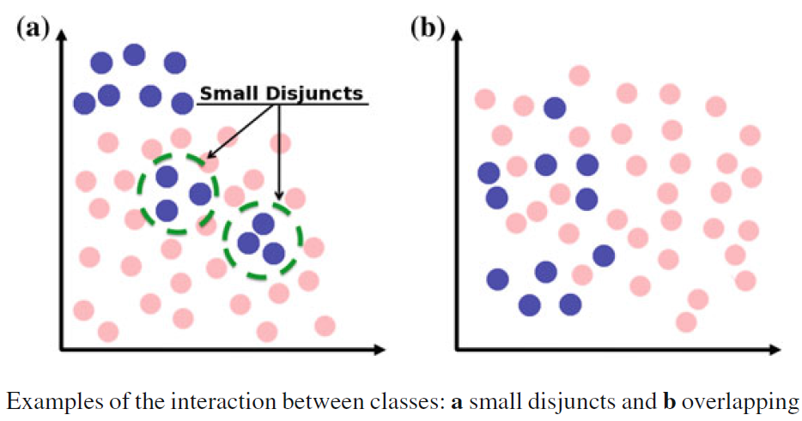
Identifying Noise

Slide 12
Identifying Noise
Another interesting problem is pointed out:
the higher or lower presence of examples located in the area surrounding class boundaries, which are called borderline examples
Misclassification often occurs near class boundaries where overlapping usually occurs
Classifier performance degradation was strongly affected by
the quantity of borderline examples
the presence of other noisy examples located farther outside the overlapping region

Slide 13
Identifying Noise
Safe examples are placed in relatively homogeneous areas with respect to the class label.
Borderline examples are located in the area surrounding class boundaries, where either the minority and majority classes overlap or these examples are very close to the difficult shape of the boundary
Noisy examples are individuals from one class occurring in the safe areas of the other class

Slide 14
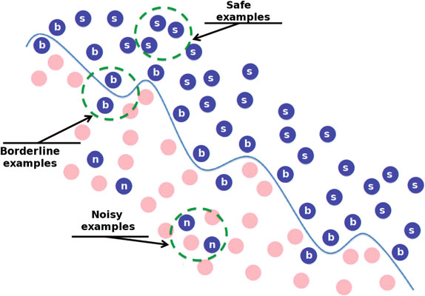
Identifying Noise

Slide 15
Identifying Noise
Safe examples are placed in relatively homogeneous areas with respect to the class label.
Borderline examples are located in the area surrounding class boundaries, where either the minority and majority classes overlap or these examples are very close to the difficult shape of the boundary
Noisy examples are individuals from one class occurring in the safe areas of the other class

Slide 16
Dealing with Noisy Data
Introduction
Identifying Noise
Types of Noise
Noise Filtering
Robust Learners Against Noise
Experimental Comparative Analysis

Slide 17
Types of Noise
A large number of components determine the quality of a data set
Among them, the class labels and the attribute values directly influence such a quality
The quality of the class labels refers to whether the class of each example is correctly assigned
the quality of the attributes refers to their capability of properly characterizing the examples for classification purposes

Slide 18
Types of Noise
Based on these two information sources, two types of noise can be distinguished:
Class noise (also referred as label noise) occurs when an example is incorrectly labeled. Two types of class noise can be distinguished:
Contradictory examples
Misclassifications
Attribute noise refers to corruptions in the values of one or more attributes → erroneous attribute values, missing or unknown attribute values, and incomplete attributes or “do not care” values

Slide 19
Types of Noise
Attribute noise is more harmful than class noise
Eliminating or correcting examples in data sets with class and attribute noise, respectively, may improve classifier performance
Attribute noise is more harmful in those attributes highly correlated with the class labels
Most of the works found in the literature are only focused on class noise

Slide 20
Noise Introduction Mechanisms
Traditionally the label noise introduction mechanism has not attracted much attention
However, the nature of noise becomes more and more important
Authors distinguish between three possible statistical models for label noise

Slide 21
Noise Introduction Mechanisms
In the most simplistic case in which the noise procedure is not dependent of either the true value of the class Y or the input attribute values X, the label noise is called noise completely at random or NCAR

Slide 22
Noise Introduction Mechanisms
Things get more complicated in the noise at random (NAR) model. Although the noise is independent of the inputs X, the true value of the class make it more or less prone to be noisy. This asymmetric labeling error can be produced by the different cost of extracting the true class, as for example in medical case-control studies, financial score assets and so on

Slide 23
Noise Introduction Mechanisms
The third and last noise model is the noisy not at random (NNAR), where the input attributes somehow affect the probability of the class label being erroneous. NNAR model is the more general case of class noise.

Slide 24
Noise Introduction Mechanisms
In the case of attribute noise, the modelization described above can be extended and adapted:
When the noise appearance does not depend either on the rest of the input features’ values or the class label the NCAR noise model applies
When the attribute noise depends on the true value but not on the rest of input values or the observed class label y the NAR model is applicable
In the last case (NNAR) the noise probability will depend on the value of the feature but also on the rest of the input feature values

Slide 25
Simulating the Noise of Real-World Data Sets
Checking the effect of noisy data on the performance of classifier learning algorithms is necessary to improve their reliability and has motivated the study of how to generate and introduce noise into the data
Noise generation can be characterized by three main characteristics:
The place where the noise is introduced
The noise distribution
The magnitude of generated noise values

Slide 26
Simulating the Noise of Real-World Data Sets
The two types of noise considered, class and attribute noise, have been modeled using four different noise schemes:
Class noise is introduced using an uniform class noise scheme (randomly corrupting the class labels of the examples) and a pairwise class noise scheme (labeling examples of the majority class with the second majority class)
Attribute noise is introduced using an uniform attribute noise scheme when erroneous attribute values can be totally unpredictable, and the Gaussian attribute noise scheme if noise is a low variation with respect to the correct value

Slide 27
Simulating the Noise of Real-World Data Sets
Robustness → compare the performance of the classifiers learned with the original (without induced noise) data set with the performance of the classifiers learned using the noisy data set
Those classifiers learned from noisy data sets being more similar (in terms of results) to the noise free classifiers will be the most robust ones.

Slide 28
Dealing with Noisy Data
Introduction
Identifying Noise
Types of Noise
Noise Filtering
Robust Learners Against Noise
Experimental Comparative Analysis

Slide 29
Noise Filtering at Data Level
Noise filters are preprocessing mechanisms to detect and eliminate noisy instances in the training set
Result → reduced training set which is used as an input to a classification algorithm
The separation of noise detection and learning has the advantage that noisy instances do not influence the classifier building design

Slide 30
Noise Filtering at Data Level
Noise filters are generally oriented to detect and eliminate instances with class noise from the training data
Elimination of such instances has been shown to be advantageous
The elimination of instances with attribute noise seems counterproductive
Instances with attribute noise still contain valuable information in other attributes which can help to build the classifier
It is also hard to distinguish between noisy examples and true exceptions

Slide 31
Noise Filtering at Data Level
We will consider three noise filters designed to deal with mislabeled instances as they are the most common and the most recent
It should be noted that these three methods are ensemble-based and vote-based filters.
Collecting information from different models will provide a better method for detecting mislabeled instances than collecting information from a single model

Slide 32
Ensemble Filter
The Ensemble Filter (EF) is a well-known filter in the literature
It uses a set of learning algorithms to create classifiers in several subsets of the training data
They serve as noise filters for the training set.
The authors originally proposed the use of C4.5, 1-NN and LDA

Slide 33
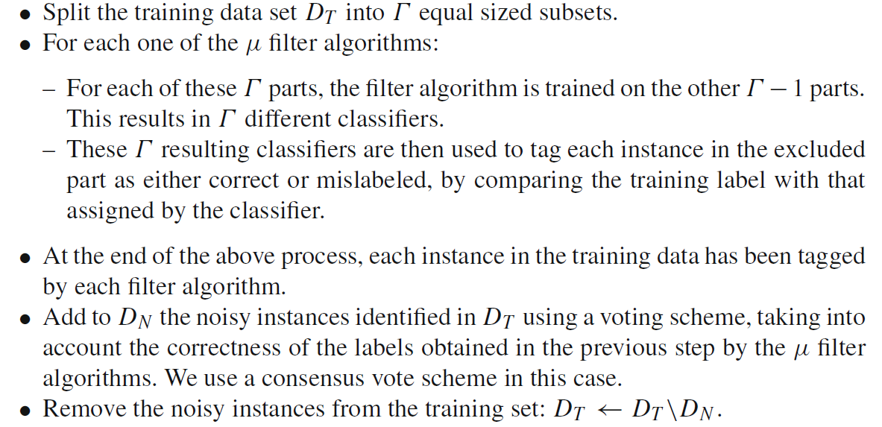
Ensemble Filter
The complete process carried out by EF is described below:

Slide 34
Cross-Validated Committees Filter
The Cross-Validated Committees Filter (CVCF) is mainly based on performing an Γ -FCV to split the full training data and on building classifiers using decision trees in each training subset
The authors of CVCF place special emphasis on using ensembles of decision trees such as C4.5

Slide 35
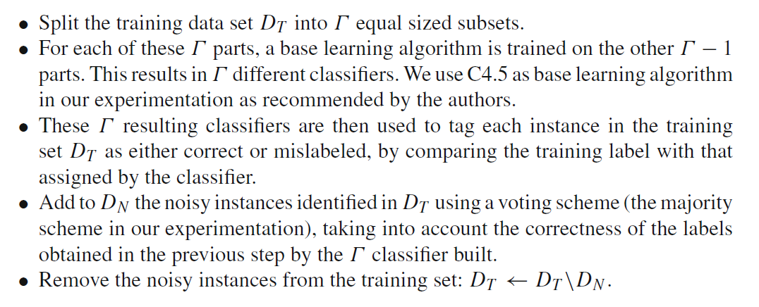
Cross-Validated Committees Filter
The basic steps of CVCF are the following:

Slide 36
Iterative-Partitioning Filter
The Iterative-Partitioning Filter (IPF) is a preprocessing technique based on the Partitioning Filter
IPF removes noisy instances in multiple iterations until the number of identified noisy instances in each of these iterations is less than a percentage p of the size of the original training data set

Slide 37
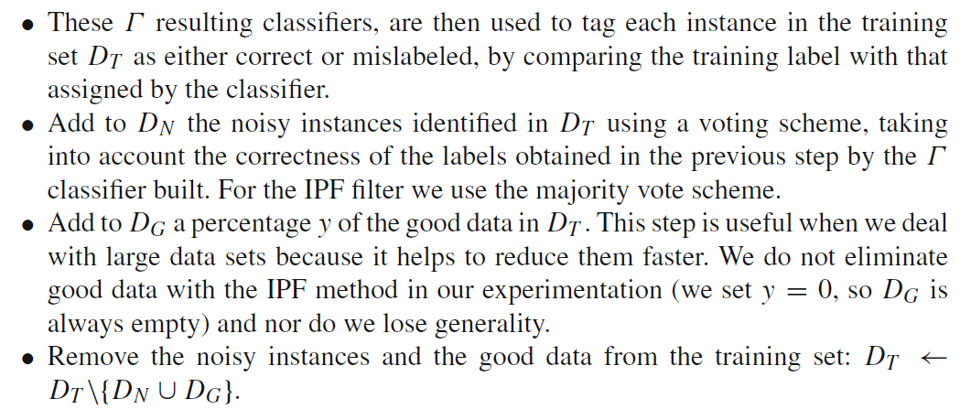
Iterative-Partitioning Filter
The basic steps of each iteration are:

Slide 38
More Filtering Methods
Apart from the three aforementioned filtering methods, we can find many more in the specialized literature
Detection based on thresholding of a measure: Measure, Least complex correct hypothesis
Classifier predictions based: Cost sensitive, SVM based, ANN based, Multi classifier system, C4.5
Voting filtering: Ensembles, Bagging, ORBoost, Edge analysis
Model influence: LOOPC, Single perceptron perturbation
Nearest neighbor based: CNN, BBNR, IB3, Tomek links, PRISM, DROP
Graph connections based: Grabiel graphs, Neighborhood graphs

Slide 39
Dealing with Noisy Data
Introduction
Identifying Noise
Types of Noise
Noise Filtering
Robust Learners Against Noise
Experimental Comparative Analysis

Slide 40
Robust Learners Against Noise
Filtering the data has also one major drawback:
some instances will be dropped from the data sets, even if they are valuable
We can use other approaches to diminish the effect of noise in the learned model
One powerful approach is to train not a single classifier but several ones

Slide 41
Robust Learners Against Noise
C4.5 has been considered as a paradigmatic robust learner against noise
It is also true that classical decision trees have been considered sensitive to class noise as well
Solutions:
Carefully select an appropriate splitting criteria measure
Prunning
This instability has make them very suitable for ensemble methods

Slide 42
Robust Learners Against Noise
An ensemble is a system where the base learners are all of the same type built to be as varied as possible
Many ensemble approaches exist and their noise robustness has been tested
The two most classic approaches are bagging and boosting
Bagging obtains better performance than boosting when label noise is present
When the base classifiers are different we talk of Multiple Classifier Systems (MCSs)

Slide 43
Robust Learners Against Noise
We can separate the labeled instances in several “bags” or groups, each one containing only those instances belonging to the same class
This type of decomposition is well suited for those classifiers that can only work with binary classification problems
It has also been suggested that this decomposition can help to diminish the effects of noise
This decomposition is expected to decrease the overlapping between the classes
It limits the effect of noisy instances to their respective bags

Slide 44
Dealing with Noisy Data
Introduction
Identifying Noise
Types of Noise
Noise Filtering
Robust Learners Against Noise
Experimental Comparative Analysis

Slide 45
Experimental Comparative Analysis
Summary of some major studies:
Using filters diminish the loss of accuracy as the noise increases
The complexity of the models obtained is also lower when using filters compared to no filtering at all
The filtering efficacy depends on the characteristics of the data and can be anticipated
Using MCSs improve the behavior of the classifier when compared to its parts (or base classifiers)
Using a one-versus-one (OVO) decomposition improves the baseline classifiers in terms of accuracy when data is corrupted by noise in all the noise schemes shown

