Slide 1
A Data Mining Software Package Including Data Preparation and Reduction: KEEL

Slide 2
KEEL
KEEL description
KEEL: Data Management
KEEL: Experimental Design
Educational Module
Integration of New Algorithms
Conclusions

Slide 3
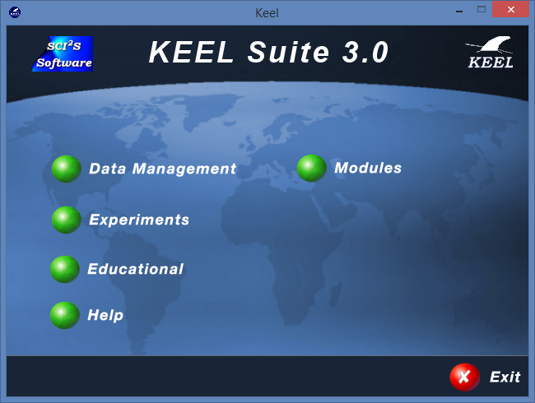
KEEL description
KEEL is a software written in Java that allows users to perform data mining experiments comprising different problems: regression, classification, clustering, mining patterns, etc...
KEEL can be used to evaluate the performance of techniques of the state-of-the-art and new proposals, since it provides the user with more than 400 different data mining algorithms.
http://www.keel.es

Slide 4
KEEL description
It includes a large library of evolutionary algorithms for MD and simplifies integration with preprocessing techniques
It incorporates statistical tools for comparative
It is implemented entirely in Java → interoperability between platforms
KEEL is distributed as free software (GPL license v3).
J. Alcalá-Fdez, L. Sánchez, S. García, M.J. del Jesus, S. Ventura, J.M. Garrell, J. Otero, C. Romero, J. Bacardit, V.M. Rivas, J.C. Fernández, F. Herrera. KEEL: A Software Tool to Assess Evolutionary Algorithms to Data Mining Problems. Soft Computing 13:3 (2009) 307-318
J. Alcalá-Fdez, A. Fernandez, J. Luengo, J. Derrac, S. García, L. Sánchez, F. Herrera. KEEL Data-Mining Software Tool: Data Set Repository, Integration of Algorithms and Experimental Analysis Framework. Journal of Multiple-Valued Logic and Soft Computing 17:2-3 (2011) 255-287.

Slide 5
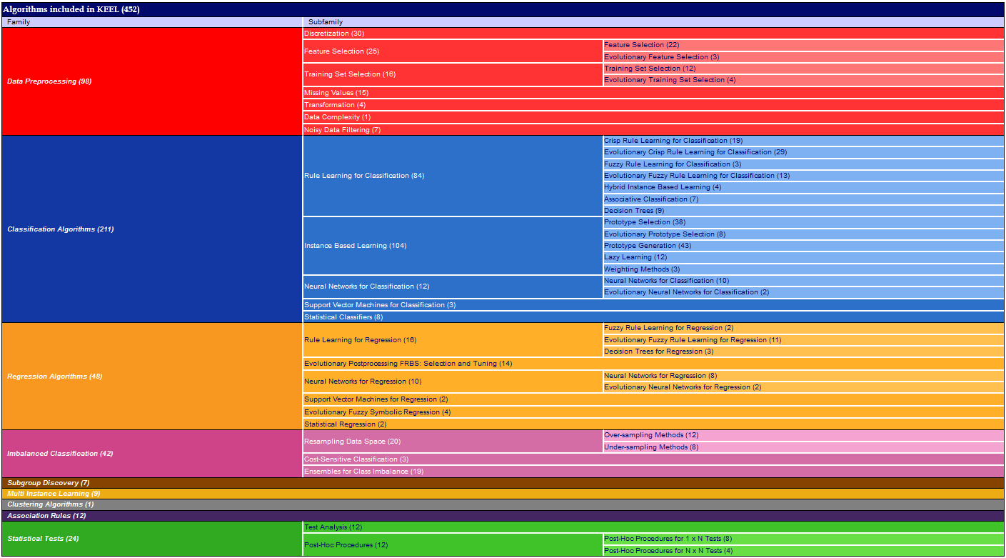
KEEL description

Slide 6
KEEL description
java –jar GraphInterKeel.jar
The KEEL tool consists of the following modules:
Data Management: Module to incorporate and adapt data sets to the KEEL environment.
Experiments: Module to design and build data mining experiments.
Educational: Module to create and execute step by step experiments, viewing the results.

Slide 7
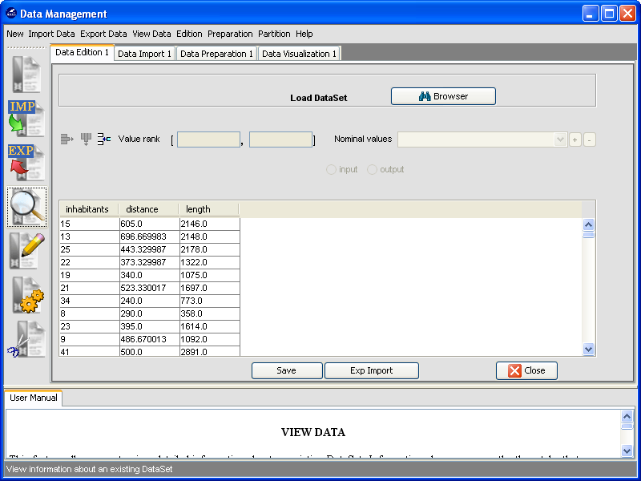
KEEL: Data Management
It allows to:
Build new data sets
Export and import to other data formats
Edit and visualize the data
Transform and partition the data

Slide 8
KEEL: Data Management

Slide 9
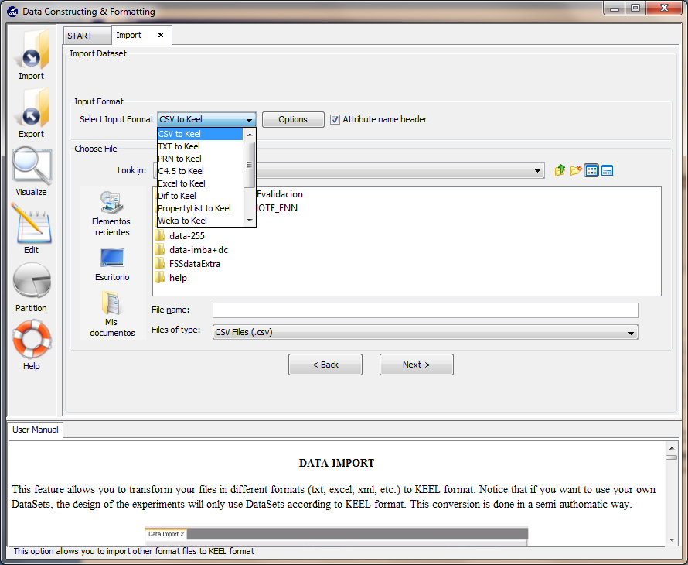
KEEL: Data Management
Import data allows you to convert data in other typical formats in the format of KEEL

Slide 10
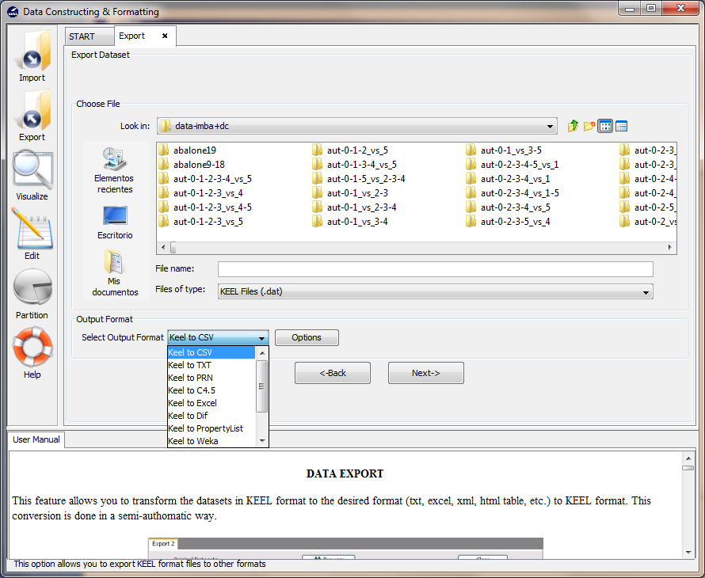
KEEL: Data Management
We also have the option to export any data set in KEEL format to a format that we want

Slide 11
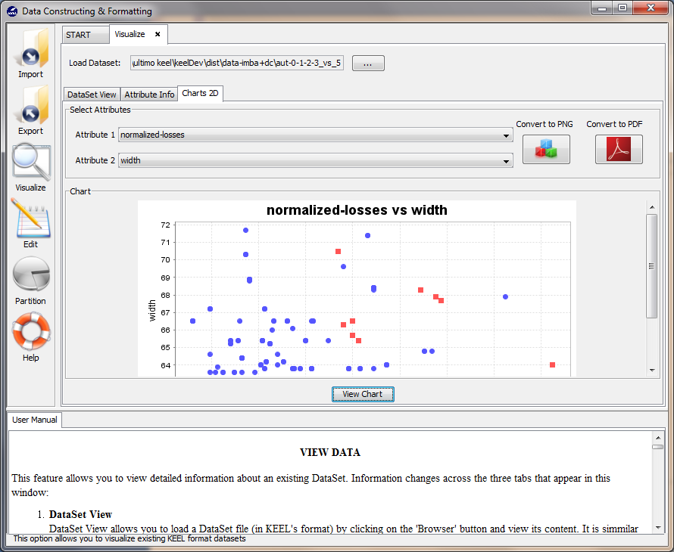
KEEL: Data Management
We can make displays 2D numerical attributes, or observe frequency histograms by class

Slide 12
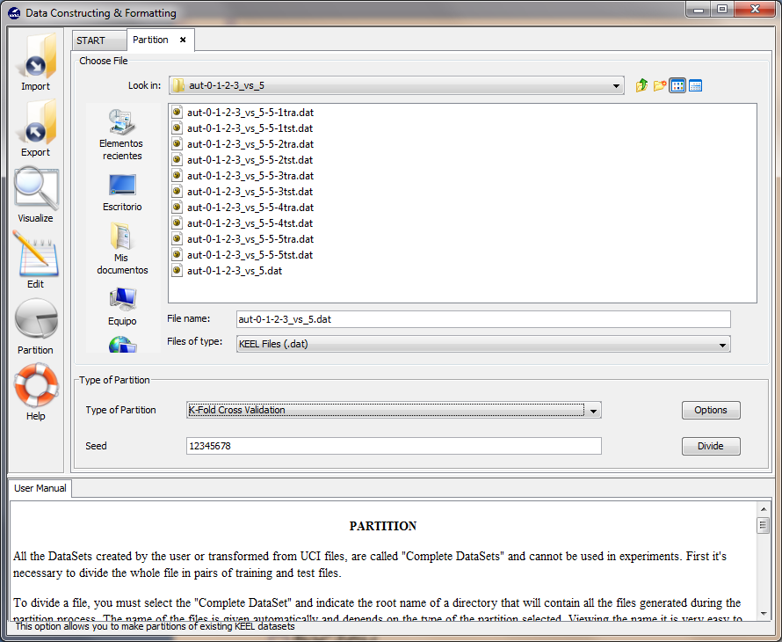
KEEL: Data Management
KEEL allows to create partitions on the data directly, using the best-known validation schemas:
K-fcv
5x2cv
LOV

Slide 13
KEEL: Experimental Design
Are they modeled graphically, representing a multiple connection between data, algorithms, methods of analysis and visualization.
Easily configurable parameters (also offered the most appropriate default values)
When designing the experiment finishes KEEL generates a program based on script that you can run on your computer
It only requires the Java virtual machine be installed

Slide 14
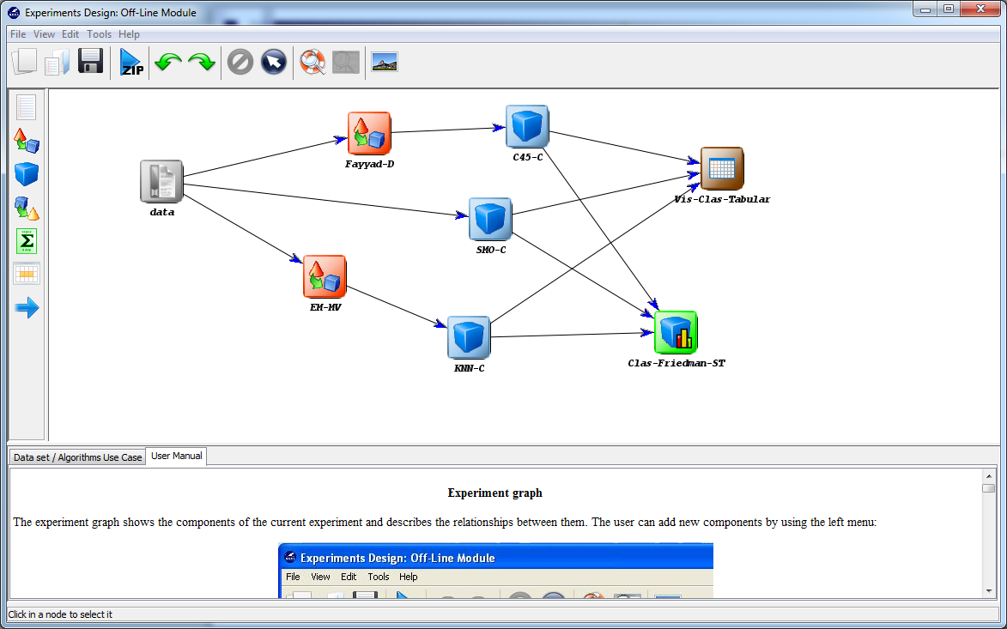
KEEL: Experimental Design

Slide 15
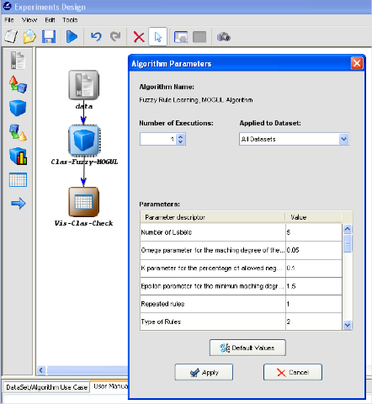
KEEL: Experimental Design
Each node can be checked with double click or right click to modify its parameters
By default the parameters recommended by the authors or those who have found that they work best are included

Slide 16
KEEL: Experimental Design
The experiment generated can be stored completely as an XML file on your computer.
You can then recover completely.
We can add new databases using the data management module, or the KEEL-Dataset repository

Slide 17
KEEL Dataset
KEEL Dataset provides a multitude of data bases adapted to the format of KEEL.
There are databases of a multitude of different problems that can be found in data mining

Slide 18
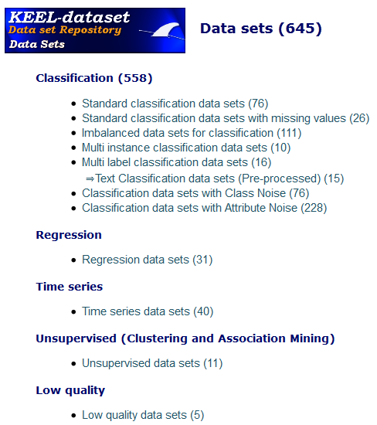
KEEL Dataset

Slide 19
KEEL Dataset
We constantly receive requests to incorporate new data sets Royal page← the basis for comparing algorithms is immense
KEEL accepts data sets ARFF Weka!
In addition, they are very similar formats and can be easily translated in both directions

Slide 20
KEEL: running the experiments
Once you get the desired graph, click on the button to generate a compressed file ready-to-run.
The experiment running must be done outside the KEEL platform → unzip the file and launch the JAR of Runkeel.jar

Slide 21
KEEL: running the experiments
KEEL advantages:
We can use the experiment batches on this machine or in a more powerful one: a cluster!
We can split large experiments in separate graphs, or easily parallelize an experiment.
We have kept the experiment and the results for the future → Published in KEEL-Dataset!

Slide 22
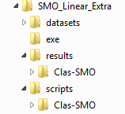
KEEL: running the experiments
The experiments created always have four directories:
datasets → It contains sets of original and preprocessed data
exe → It contains the JAR of each of the methods
results → It contains the results obtained by each algorithm
scripts → It contains the files of configuration and control of the experiment

Slide 23
KEEL: running the experiments
Particularly interesting is the file Runkeel.xml in the directory scripts.
Controls each of the executions which are going to be executed.
It faithfully reflects the flow of execution of the graph of the designed experiment
Modifications to this file affect the experiment!← We have control over what you can run or not, and even to parallelize it

Slide 24
KEEL: running the experiments
Each algorithm to run is encoded as a separate JAR exe directory
We can replace it with a newer version and our experiment is still valid
We can use the JAR in individual tests out the experiments

Slide 25
KEEL: running the experiments
Each JAR of an algorithm always receives a single parameter.
This parameter is a path into a file in plain text which encodes the parameters and paths of the files of data necessary for the algorithm

Slide 26
KEEL: running the experiments
The first line specifies the algorithm for which the parameter file is intended

Slide 27
KEEL: running the experiments
The second line contains the input files:
Training file “*tra.dat”
Validation file “*tra.dat”
Test file “*tst.dat”

Slide 28
KEEL: running the experiments
The second line contains the output files which should produce the algorithm:
Training output file “.tra”
Test output file “.tst”

Slide 29
KEEL: running the experiments
After a blank line follow the particular parameters of the algorithm
If there is a seed (stochastic algorithm) always is the first parameter “seed = 56464511635156”
Then the rest of parameters follow

Slide 30
KEEL: running the experiments
The meaning of parameters depends on each algorithm!
We specify their meaning in the window of design of experiments, which contains support for each algorithm

Slide 31
KEEL Modules
It also has the following additional modules
Additional modules provide frameworks for private and known Data Mining problems.
Imbalanced Learning: Module to design experiments that deal with problems of unbalanced data.
Non-Parametric Statistical Analysis: Module to contrast the results obtained in experiments using test non-parametric statistics.
Multiple Instance Learning: Module to design experiments that deal with problems multiinstancia.

Slide 32
Educational Module
KEEL has been used successfully in subjects of several international master programmes on data mining and machine learning.
With regard to the teaching of fuzzy systems, KEEL offers great potential because it has a wide range of algorithms and preprocessing techniques.

Slide 33
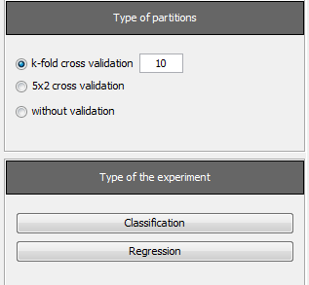
Educational Module
It is a version of the module of experiments aimed to show the most popular data mining techniques.
Design of experiments in the education module can be simply:
1st step: choose the type of experiment and schema validation.

Slide 34
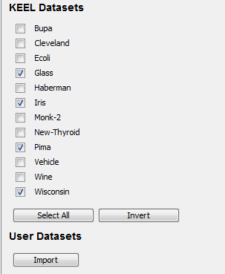
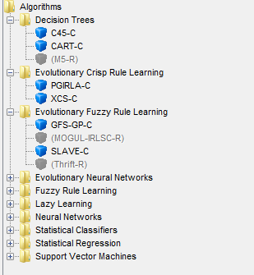
Educational Module
Step 2 : select which data sets are going to be used.
Step 3: choose the algorithms.

Slide 35
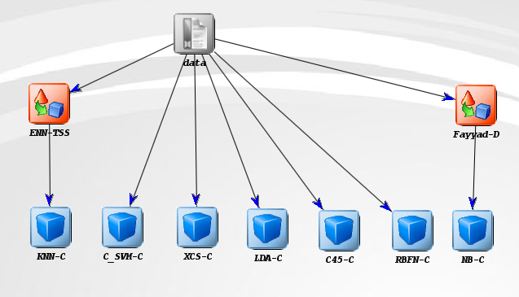
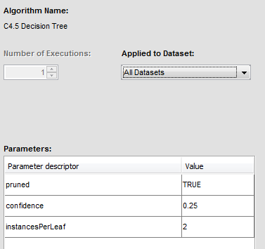
Educational Module
Step 4: draw the graph of the experiment and set the parameters for each method.

Slide 36
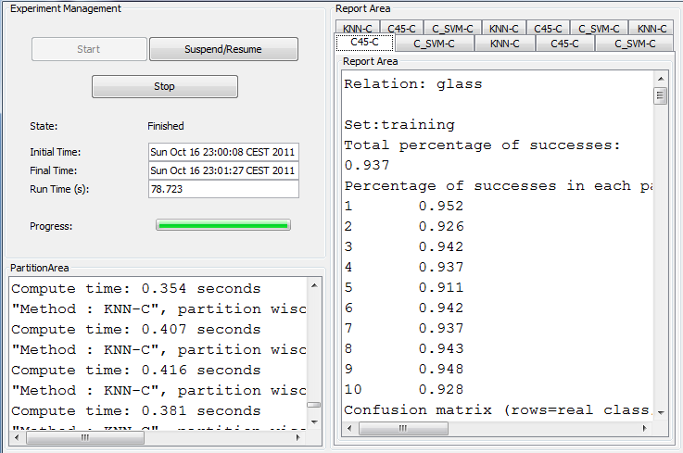
Educational Module
Step 5: run the experiment.

Slide 37
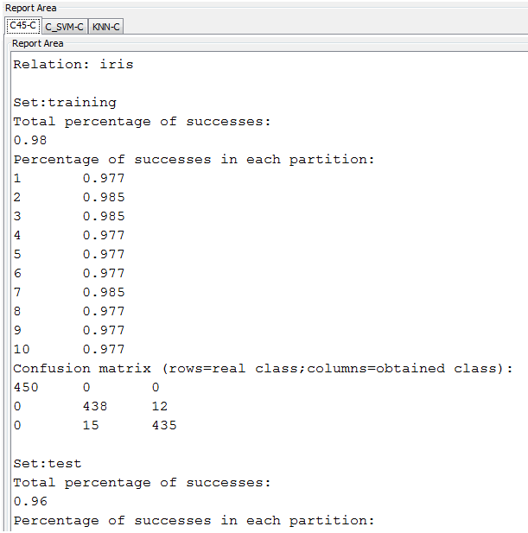
Educational Module
Step 6: obtain the results.

Slide 38
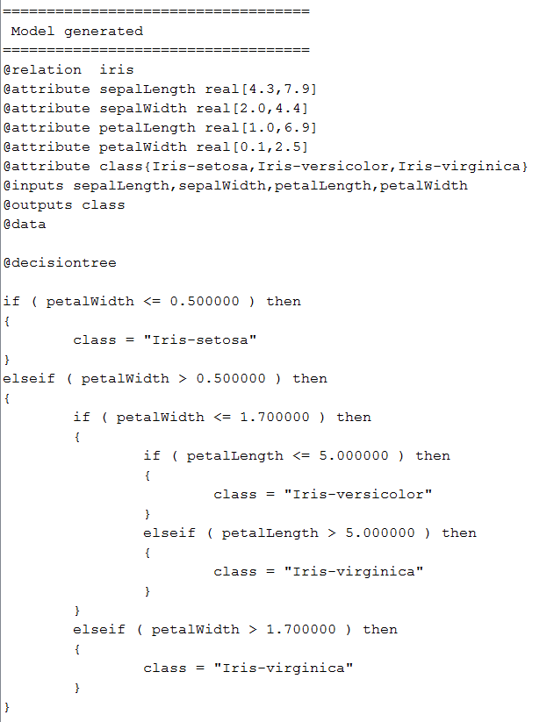
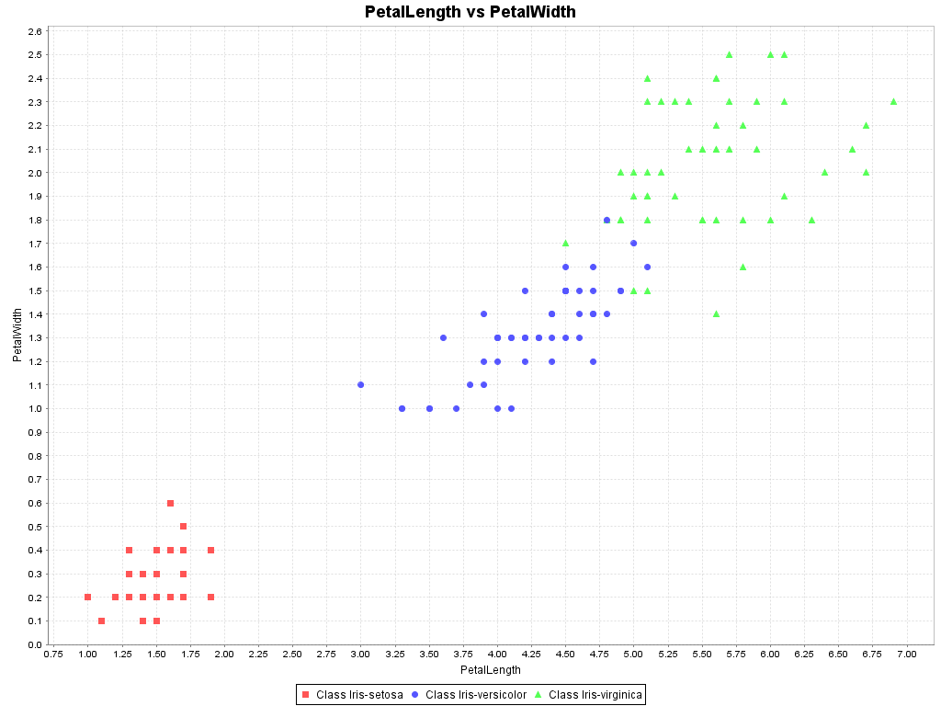
Educational Module
Step 7: analyze the generated models
Decision tree

Slide 39
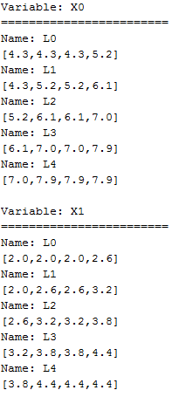
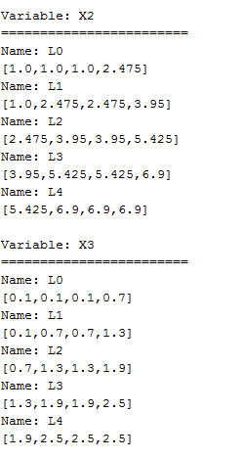
Educational Module
Fuzzy Rule Base System

Slide 40
Integration of New Algorithms
List of details to take into account before codifying a method for KEEL:
The programming language used is Java.
The parameters are read from a single file, which includes:
The name of the algorithm
The path of the input and output files
List of parameter’s values for the algorithm.

Slide 41
Integration of New Algorithms
The input data-sets follow the KEEL format that extends the ARFF format by completing the header with more information about the attributes.
The output format consists of:
A header, which follows the same scheme as the input data
Two columns with the output values for each example separated with a white space
Examples |  | Pedicted Value
Inputs | Output
1.9, 3.5 | Red | Yellow
0.5, 9.1 | Blue | Blue
@relacion furniture
@attribute height real [1, 10]
@attribute width real [1, 10]
@data
Red Yelow
Blue Blue
http://www.keel.es/documents/KeelReferenceManualV1.0.pdf

Slide 42
Integration of New Algorithms
The KEEL development team have created a simple template that manages all these features.
KEEL template includes four classes:
Main: This class contains the main instructions for launching the algorithm.
ParseParameters: This class manages all the parameters.
myDataset: This class is an interface between the classes of the API dataset and the algorithm.
Algorithm: This class is devoted to store the main variables of the algorithm and to call the different procedures for the learning stage
http://www.keel.es/software/KEEL_template.zip

Slide 43
Integration example
We have selected one classical and simple method, the Chi et al.'s rule learning procedure.
Neither the Main nor ParseParameters nor myDataset classes need to be modified.
We need to only focus our effort on the Algorithm class.

Slide 44
Integration example
3 steps:
Store all the parameter’s values within the constructor of the algorithm
public Fuzzy_Chi(parseParameters parameters) f
train = new myDataset(); val = new myDataset(); test = new myDataset();
try { System.out.println("nnReading the training set: " + parameters.getTrainingInputFile());
train.readClassificationSet(parameters.getTrainingInputFile(), true);
System.out.println("nnReading the validation set: " + parameters.getValidationInputFile());
val.readClassificationSet(parameters.getValidationInputFile(), false);
System.out.println("nnReading the test set: " + parameters.getTestInputFile());
test.readClassificationSet(parameters.getTestInputFile(), false);
}
catch (IOException e) {
System.err.println( "There was a problem while reading the input data-sets: + e);
somethingWrong = true;
}
//We may check if there are some missing attributes
somethingWrong = somethingWrong || train.hasMissingAttributes();
/
/Now we parse the parameters
nLabels = Integer.parseInt(parameters.getParameter(0));
String aux = parameters.getParameter(1); // Computation of the compatibility degree

Slide 45
Integration example
Execute the main process of the algorithm:
Abort the program if we have found some problem
Perform the algorithm's operations
public void execute() {
if (somethingWrong) { //We do not execute the program
System.err.println("An error was found, the data-set have missing values");
System.err.println("Please remove those values before the execution");
System.err.println("Aborting the program");
}
//We should not use the statement: System.exit(-1);
else { //We do here the algorithm's operations
nClasses = train.getnClasses();
dataBase = new DataBase(train.getnInputs(), nLabels,
train.getRanges(),train.getNames());
ruleBase = new RuleBase(dataBase, inferenceType, combinationType,
ruleWeight, train.getNames(), train.getClasses());
System.out.println("Data Base:nn"+dataBase.printString());
ruleBase.Generation(train);

Slide 46
Integration example
Write the output files:
The DB and the RB
Two output files with the classication for both validation and test files (doOutput)
public void execute () {
.
.
.
dataBase.writeFile(this.fileDB);
ruleBase.writeFile(this.fileRB);
//Finally we should fill the training and test output files
double accTra = doOutput(this.val, this.outputTr);
double accTst = doOutput(this.test, this.outputTst);
System.out.println("Accuracy obtained in training: "+accTra);
System.out.println("Accuracy obtained in test: "+accTst);
System.out.println("Algorithm Finished");}
}
private double doOutput(myDataset dataset, String filename) {
String output = new String(""); int hits = 0;
output = dataset.copyHeader(); //we insert the header in the output file
// We write the output for each example
for (int i = 0; i < dataset.getnData(); i++) { //for classification:
String classOut = this.classificationOutput(dataset.getExample(i));
output += dataset.getOutputAsString(i) + " " + classOut + "nn";
if (dataset.getOutputAsString(i).equalsIgnoreCase(classOut)) {
hits++;
}
}
Files.writeFile(filename, output);
return (1.0*hits/dataset.size());
}
http://www.keel.es/software/Chi_source.zip

Slide 47
Conclusiones
It offers the techniques most representative of the State of the art in preprocessing, as well as classification and regression.
Design of experiments is very simple. They can be executed from the tool itself, and its results can be analyzed using the tools of the module itself.
El módulo Educativo de KEEL es una herramienta útil para apoyar a estudiantes y profesores en la docencia de asignaturas de minería de datos (incluyendo sistemas difusos).
KEEL is free software: is distributed as Open Source from the website of the project http://www.keel.es

